Slide 1
Fibre Channel Roadmap Graphics
Scott Kipp
skipp@brocade.com
Notes:
1

Slide 2
The Fibre Channel Roadmap
The Fibre Channle Roadmap resources can be found at: www.fibrechannel.org/roadmap
The resources include:
A pdf of the map for printing
This presentation that has the individual graphics that can be used in presentations.
Notes:
2

Slide 3
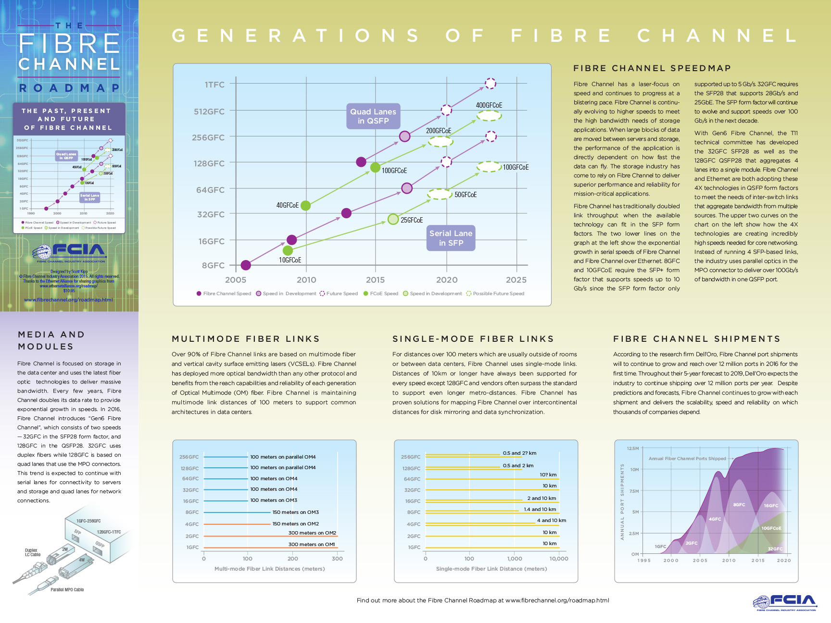
Whole Image of Front

Slide 4
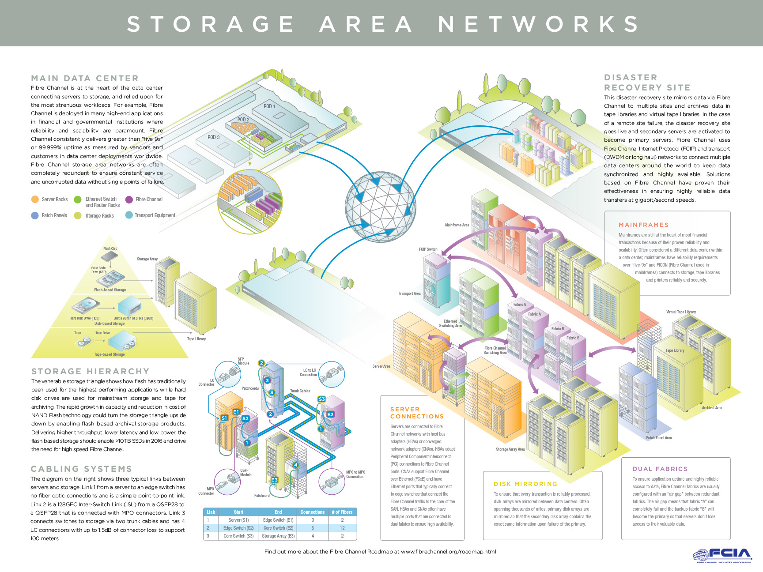
Whole Image of Back

Slide 5
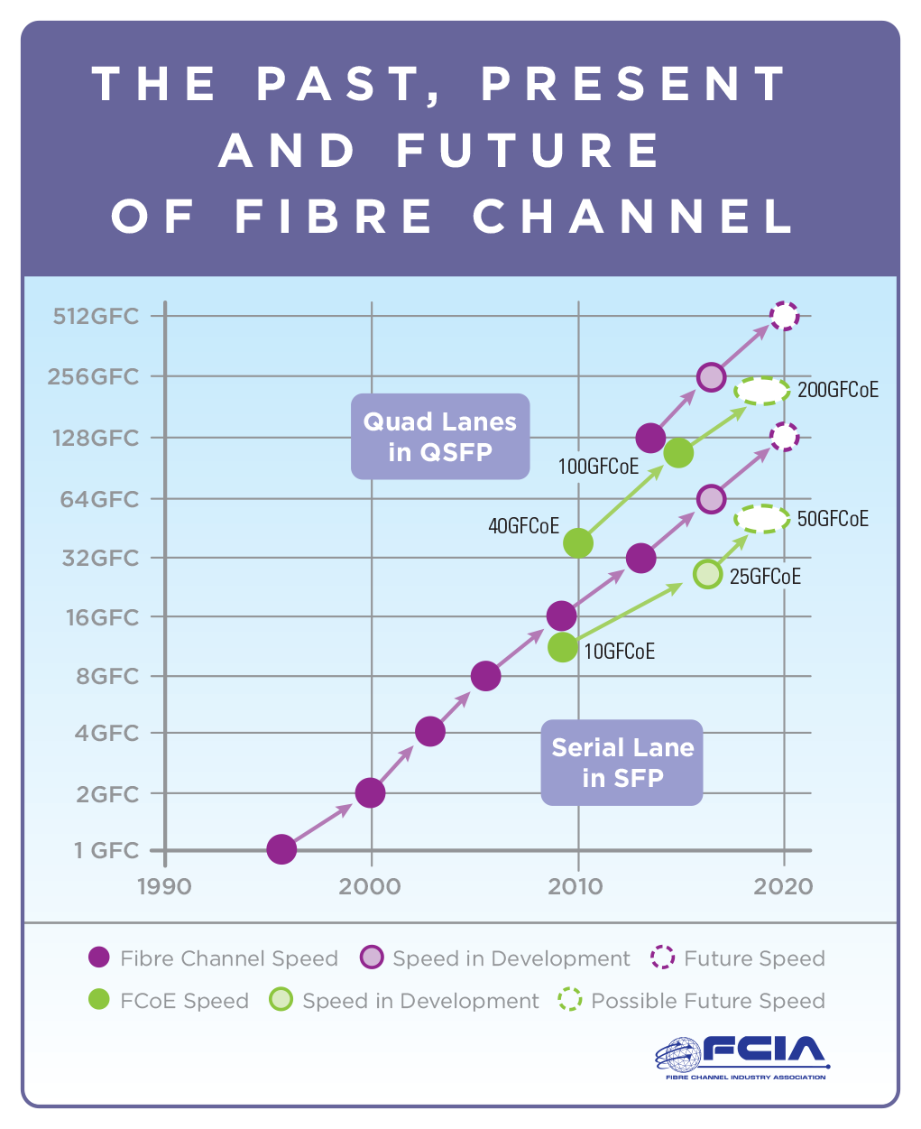
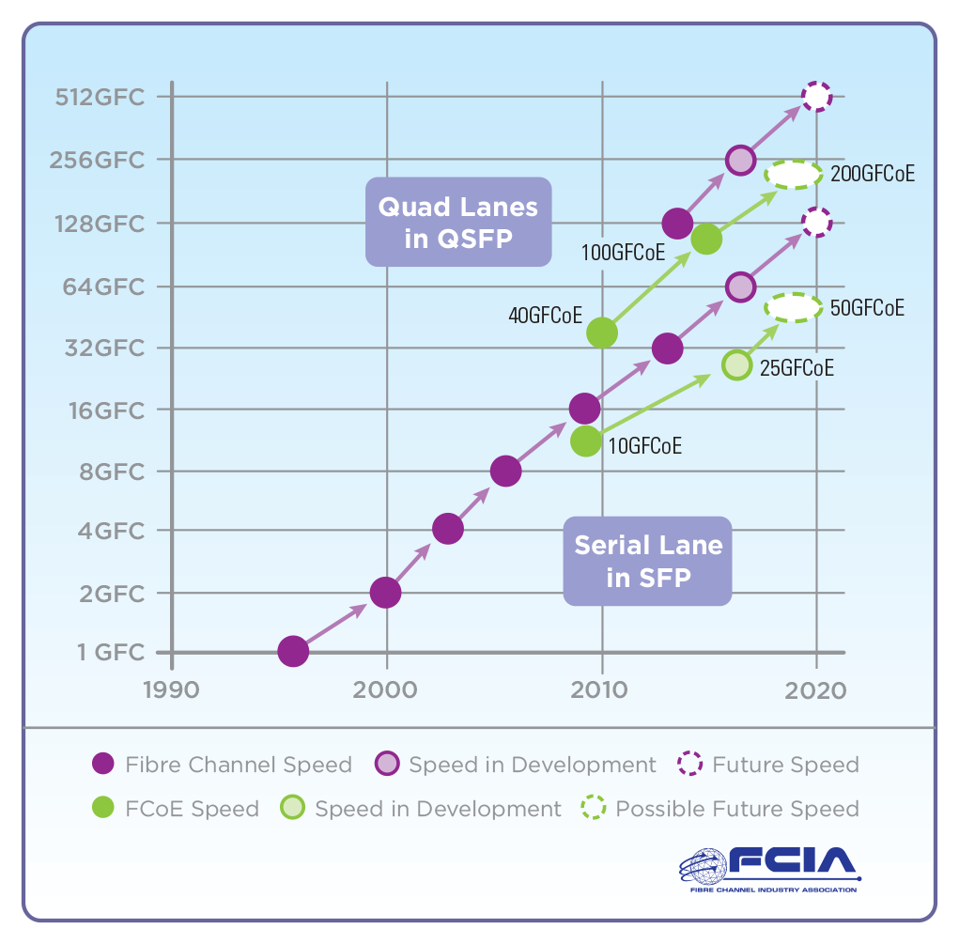
Front Graphic

Slide 6
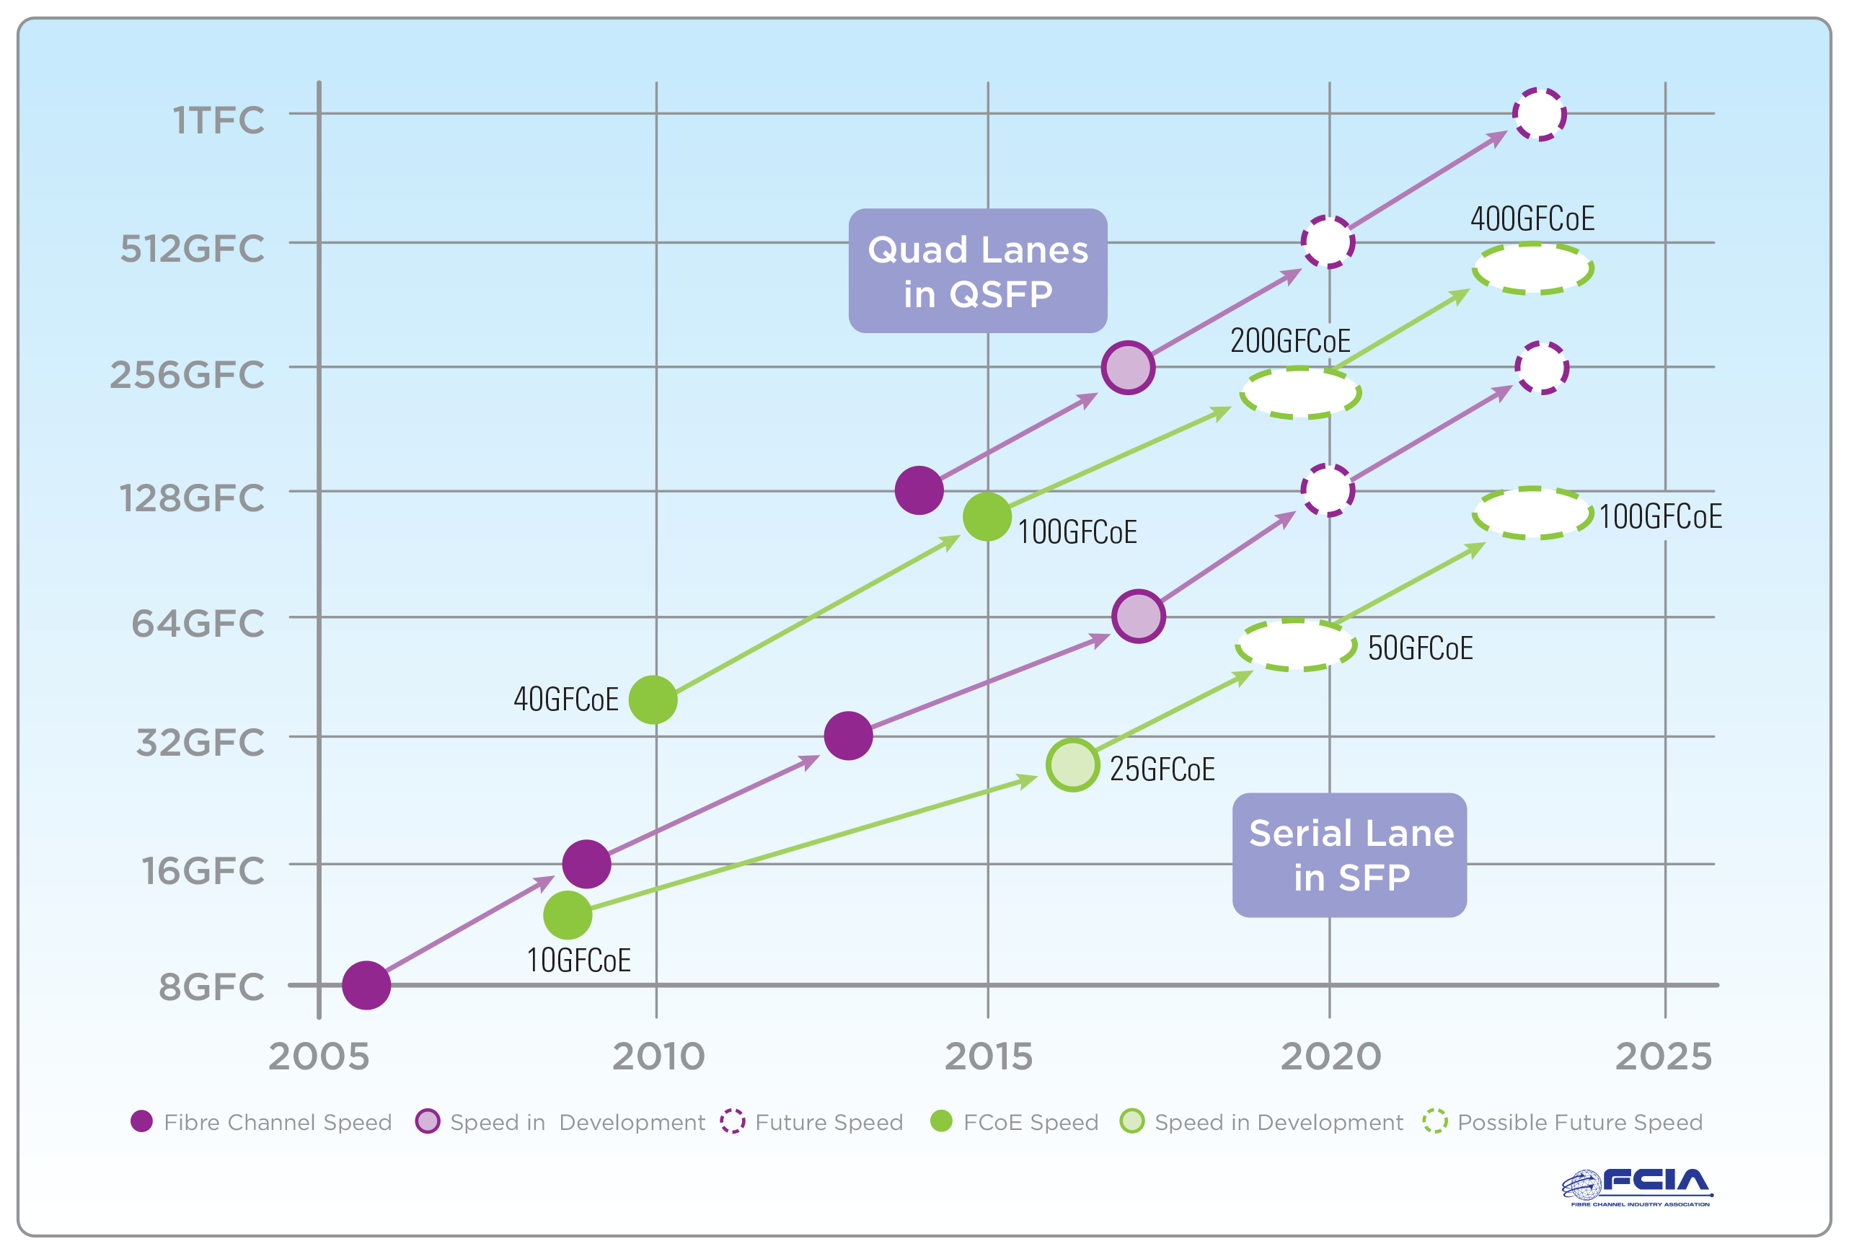
Fibre Channel Roadmap 2

Slide 7
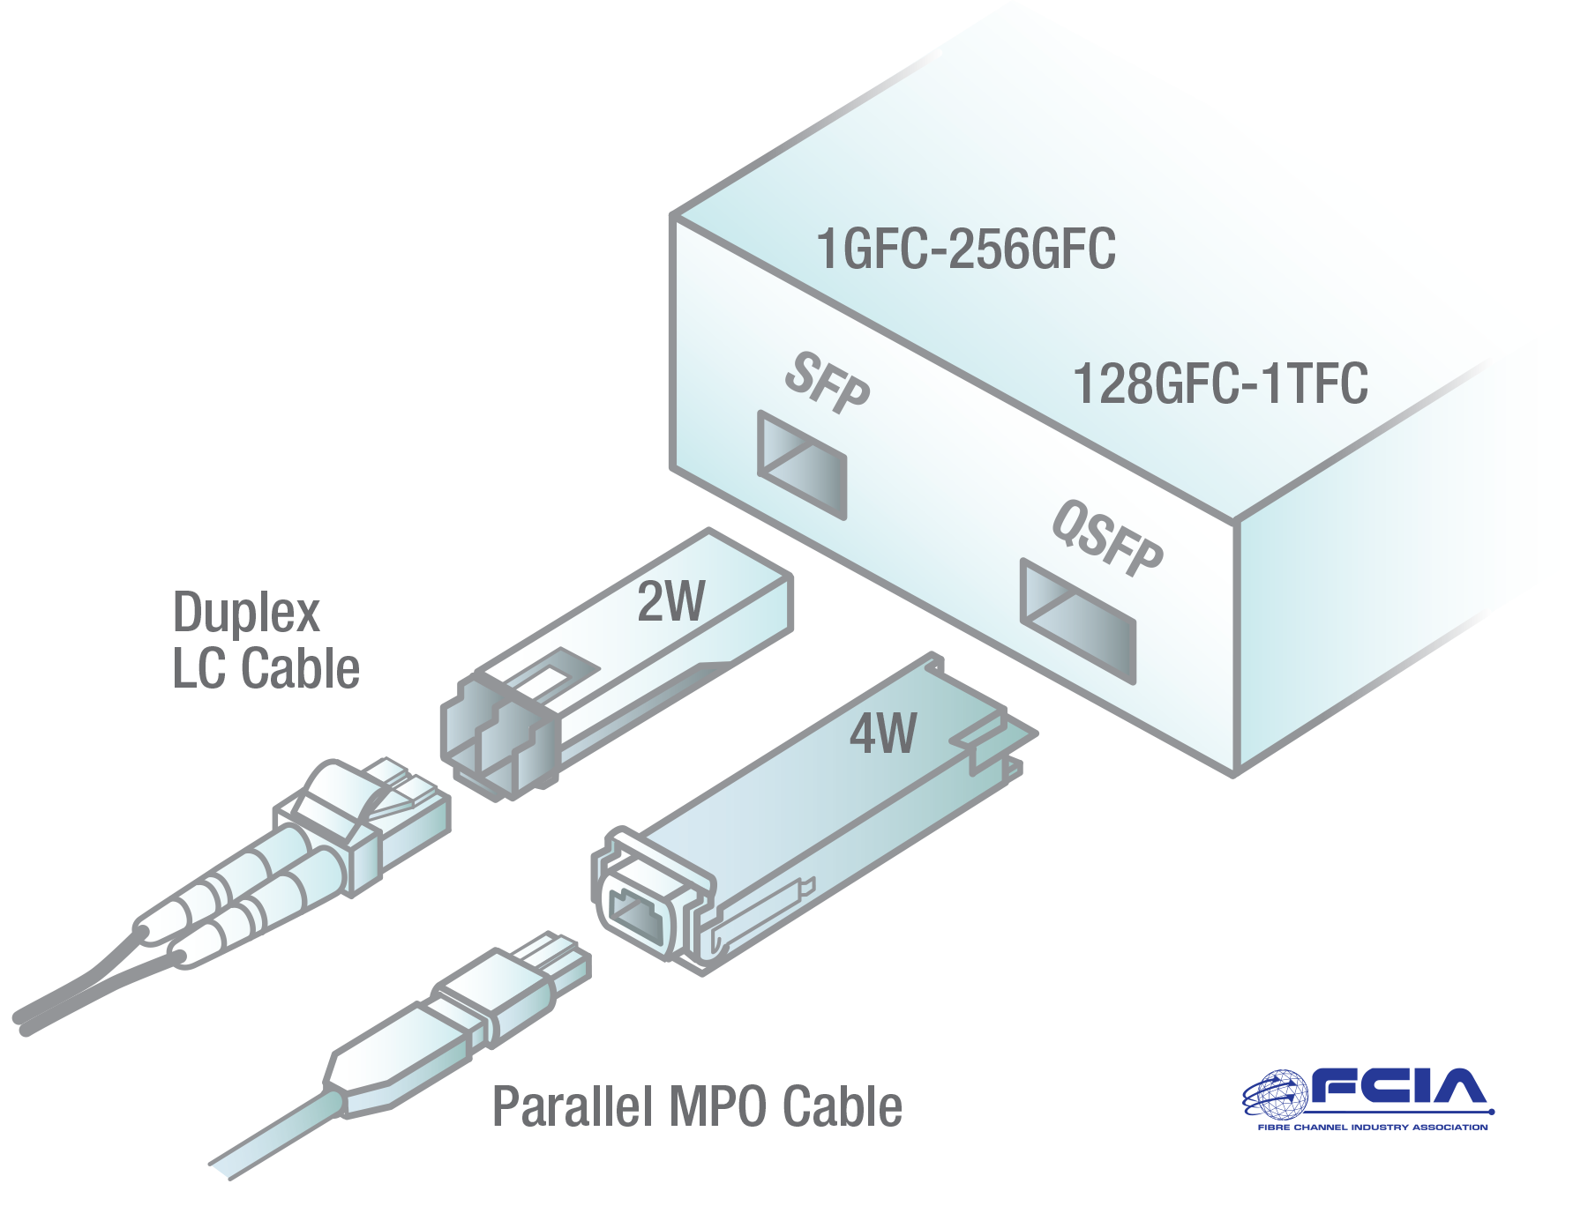
Module Types

Slide 8
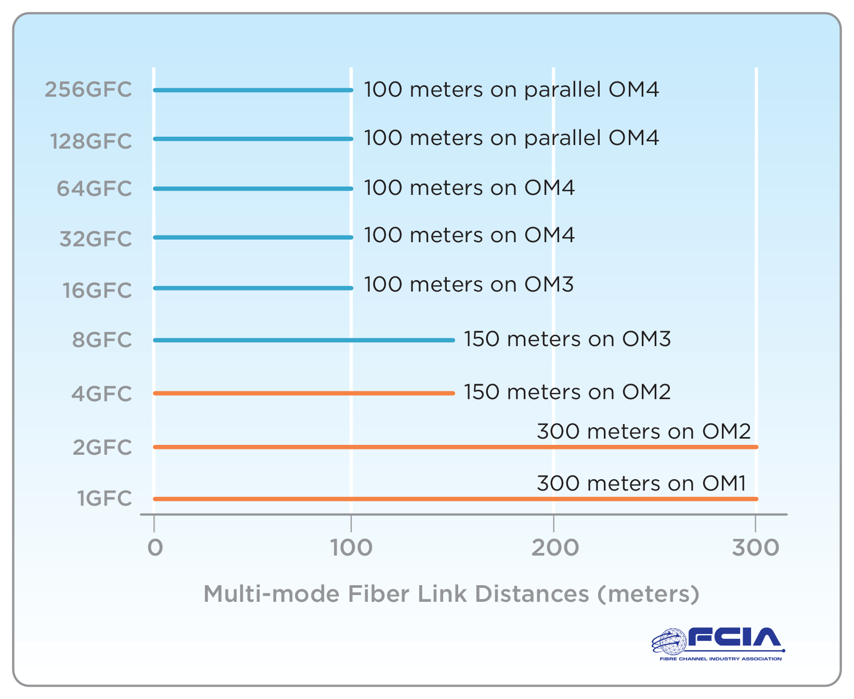
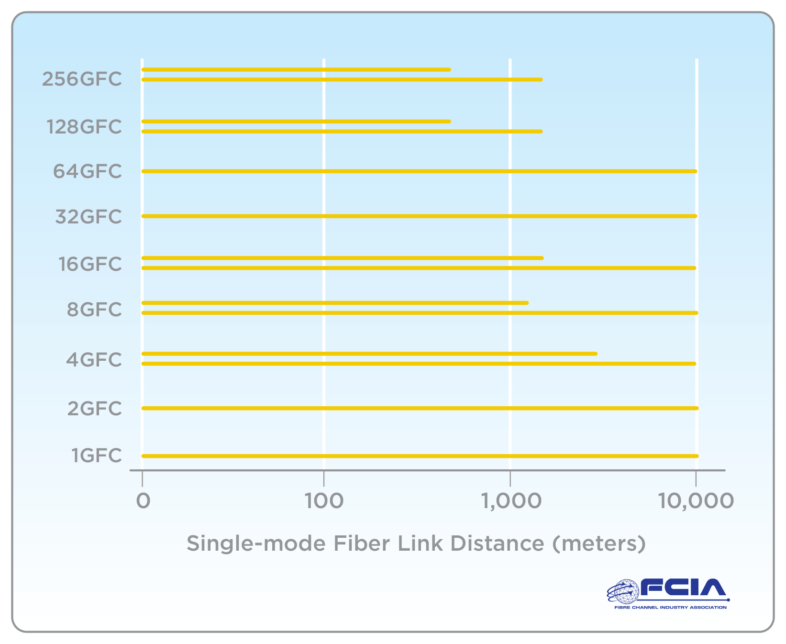
Link Reach

Slide 9
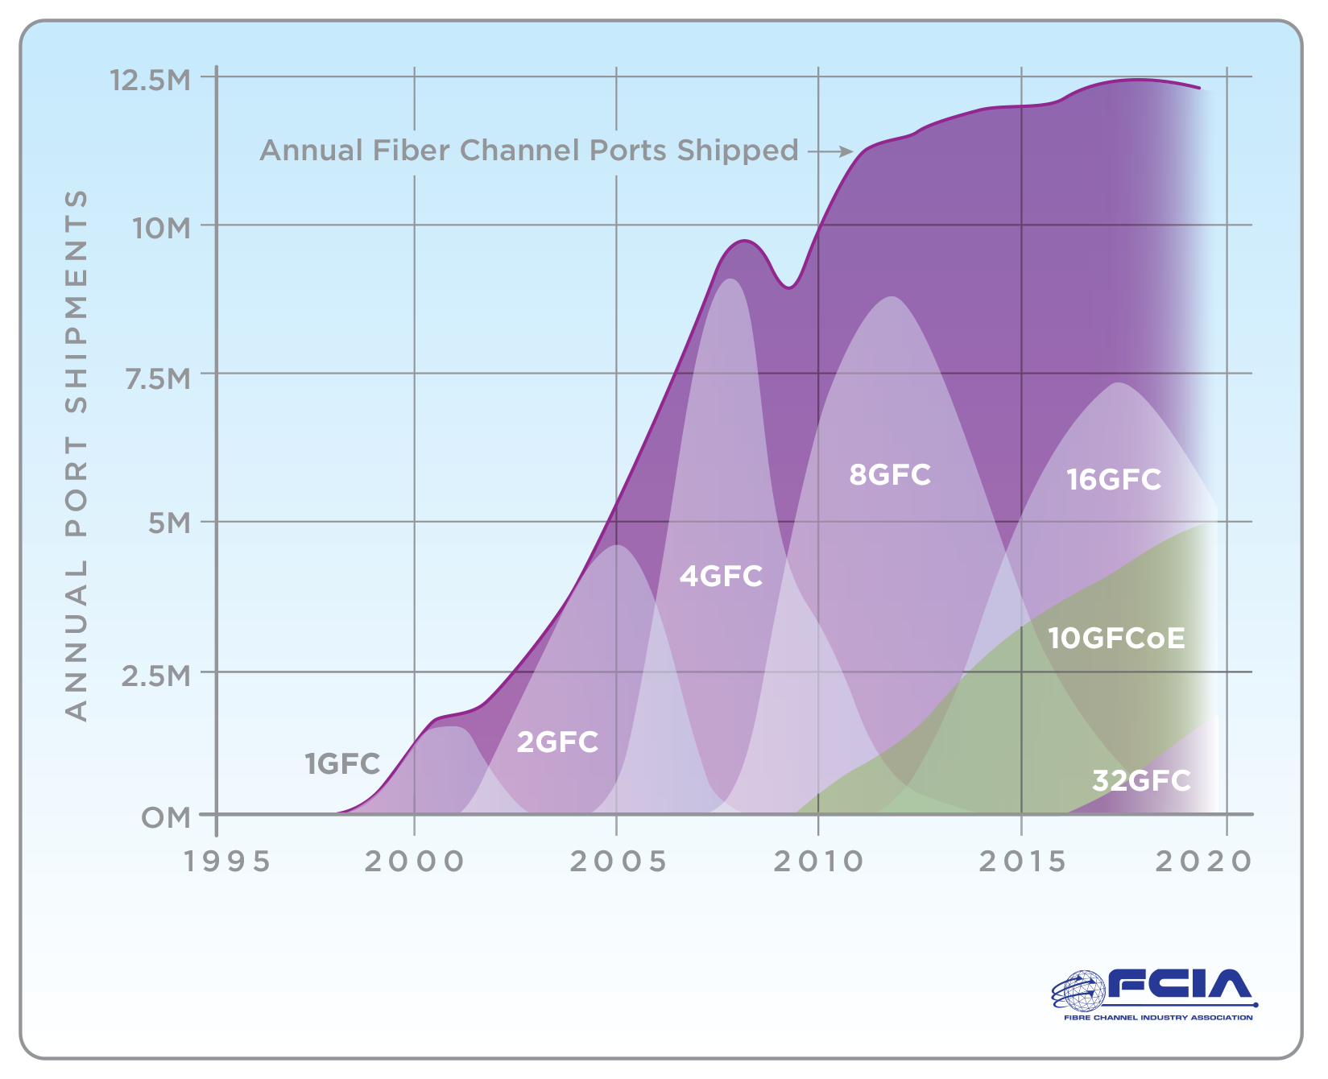
Fibre Channel Port Shipments

Slide 10
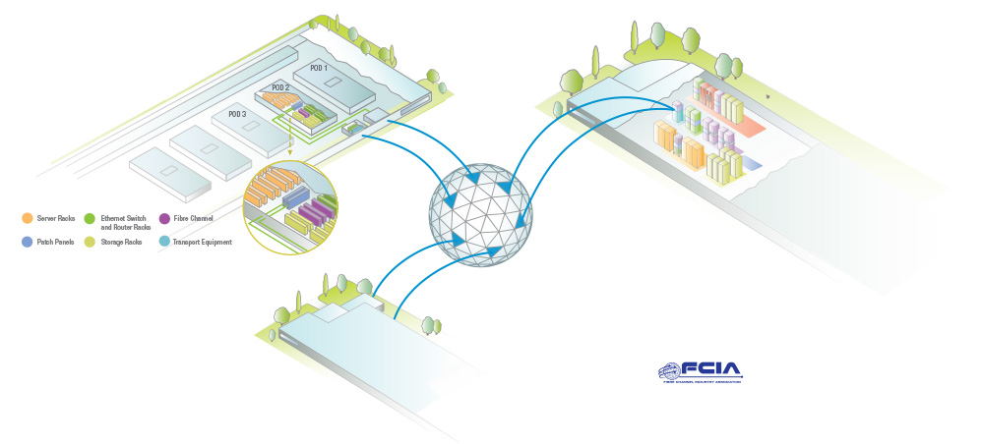
Data Centers and WAN
Break out this circle and the key in a separate drawing.
The top data center should be broken out separate from the other data centers too.

Slide 11
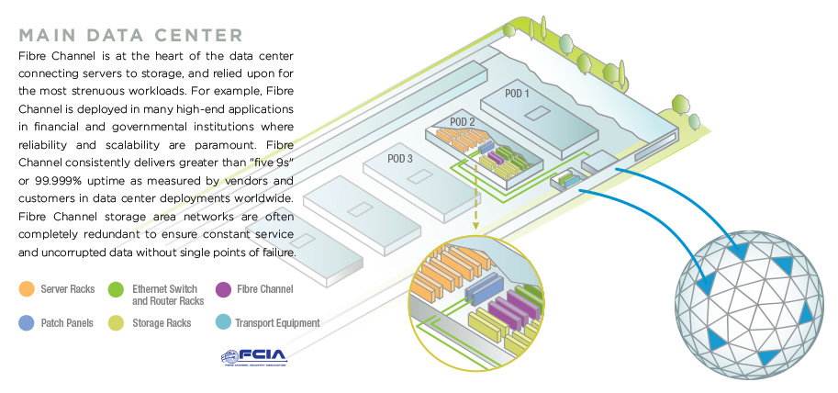
Data Center to WAN

Slide 12
Data Center Racks

Slide 13
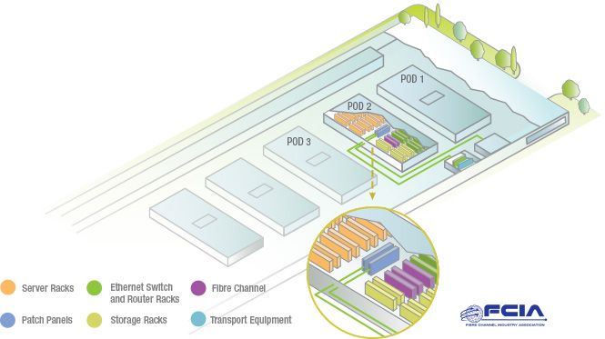
POD Data Center with Breakout

Slide 14
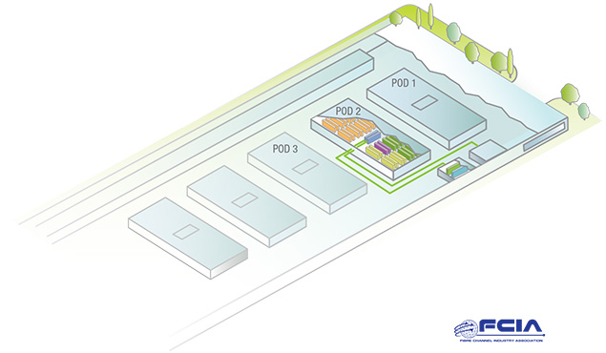
POD Data Center

Slide 15
Data Center Small

Slide 16
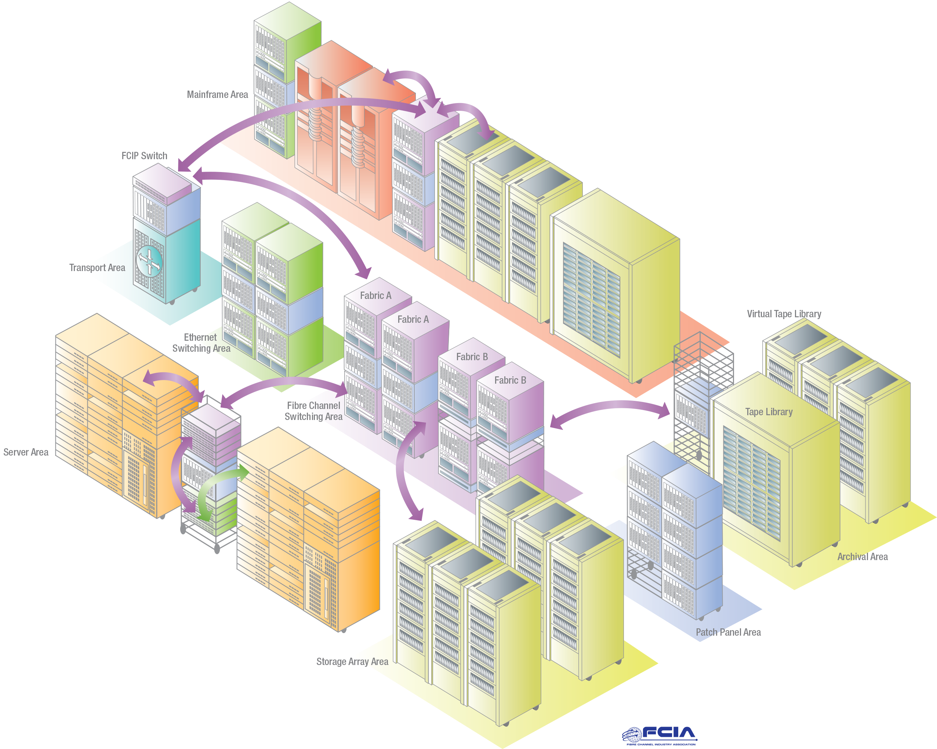
Data Center

Slide 17
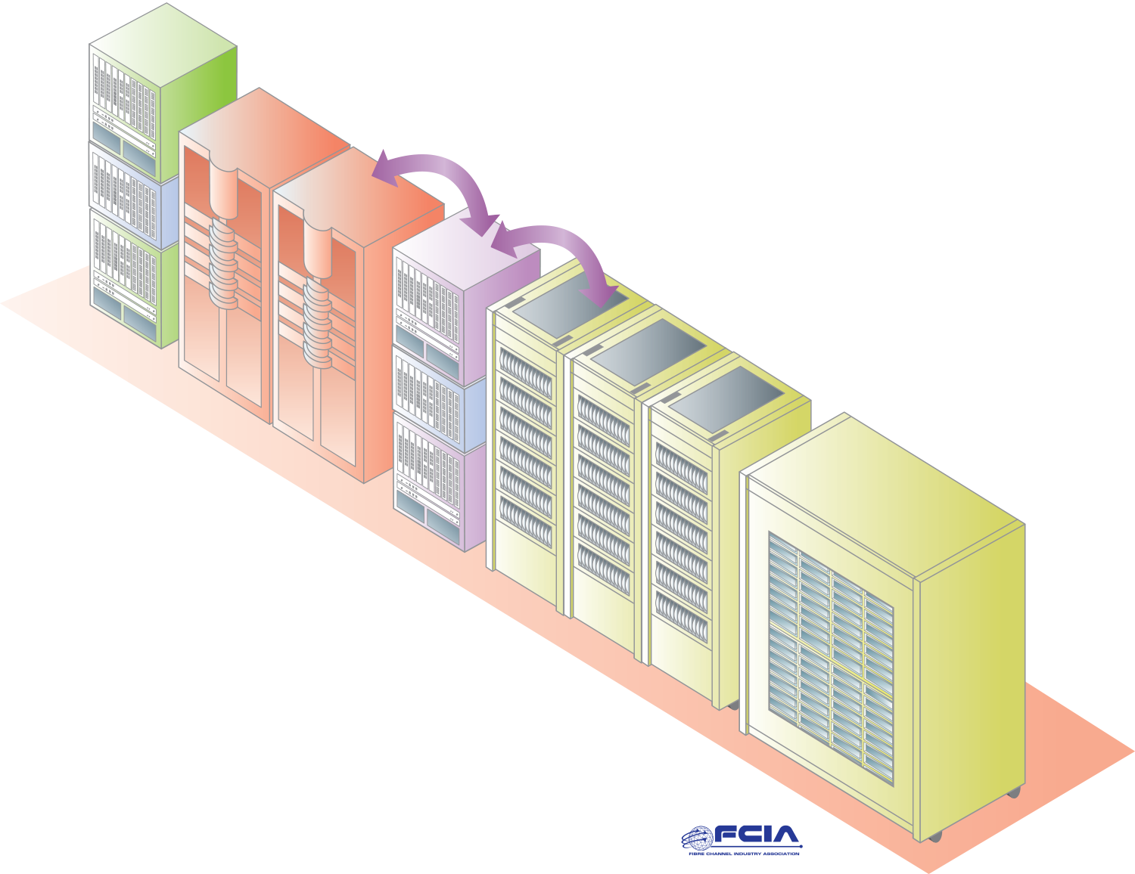
Mainframes

Slide 18
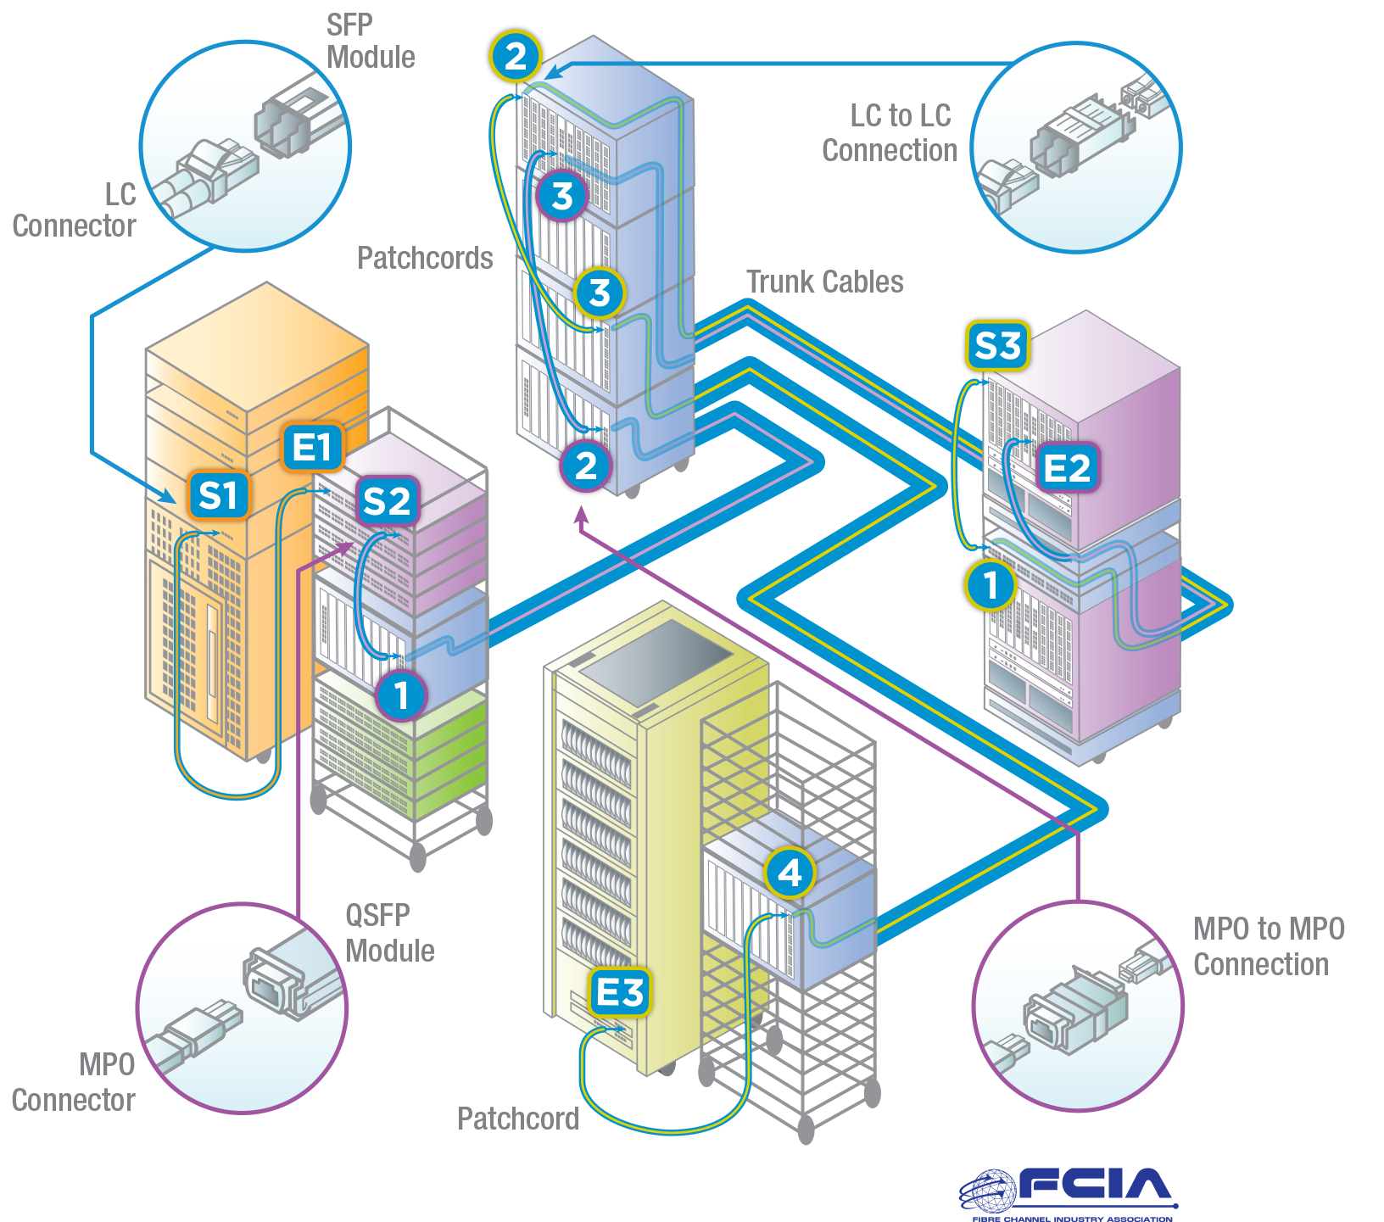
Cabling Systems

Slide 19
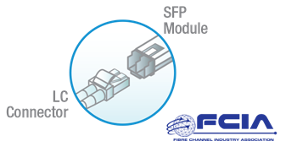
Fiber Optic Connections

Slide 20
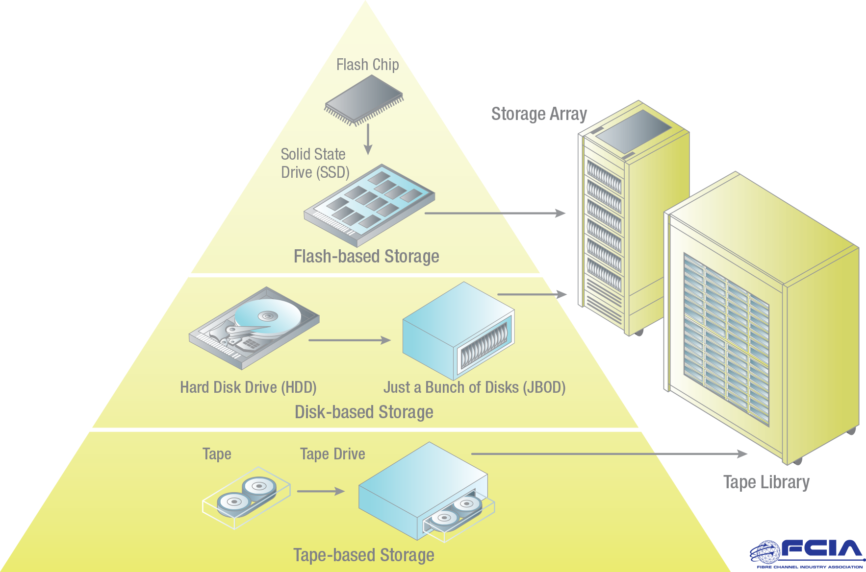
Storage Triangle

