Slide 1
FCIA Fibre Channel Plugfest October 23, 2023 Presented by: James Kahn www.iol.unh.edu

Slide 2
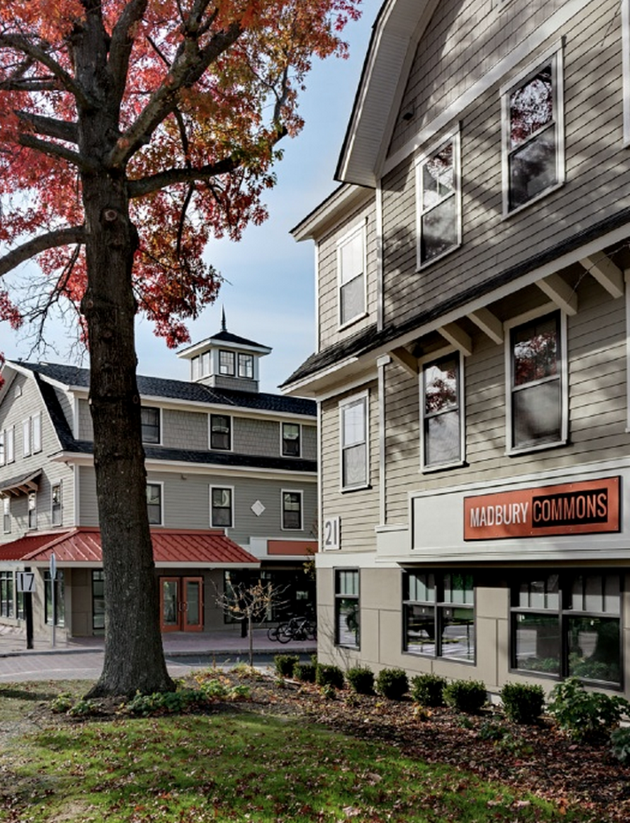
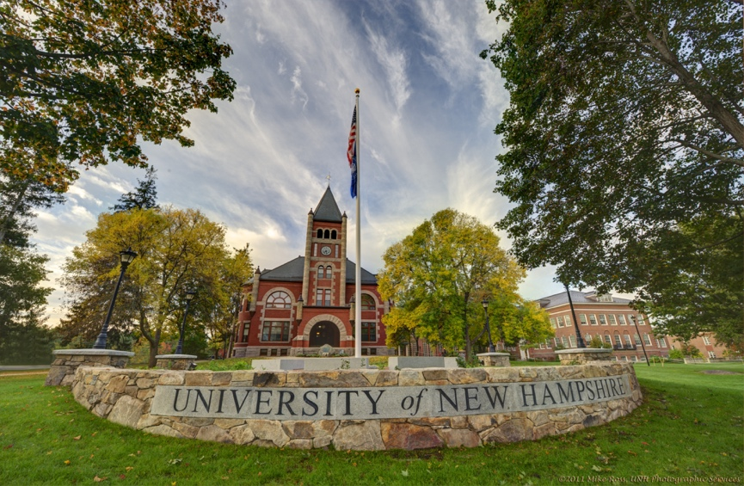
University of New Hampshire
InterOperability Laboratory
UNH founded in 1866 - InterOperability Laboratory founded in 1988
Main campus located in Durham, New Hampshire, USA
The UNH-IOL is a non-profit neutral, third-party laboratory dedicated to testing data networking technologies through industry collaboration.

Slide 3
FCIA FC Plugfest
Week of October 23, 2023, held at the UNH-IOL in Durham, NH
Primary purpose is to perform Fibre Channel Plugfest testing determined on the FCIA calls in the coming weeks.

Slide 4
Be Prepared!
Bring 2+ Samples of each product
Please bring at least 2 samples of your product, just in case
Bring any necessary PCs, tools, cables that will be necessary to update or access your device while here at the lab.
Remember your management cables.

Slide 5
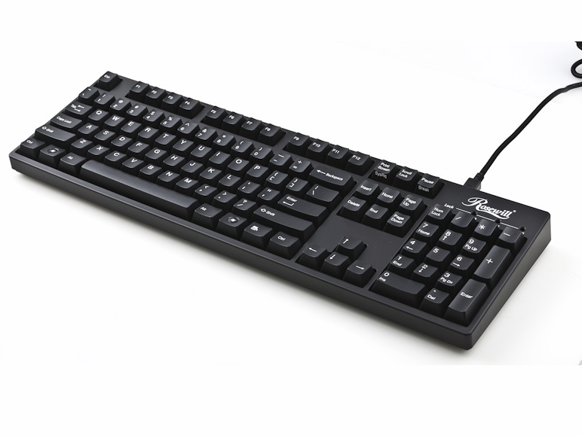
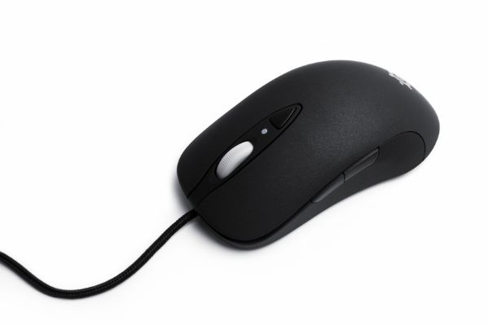
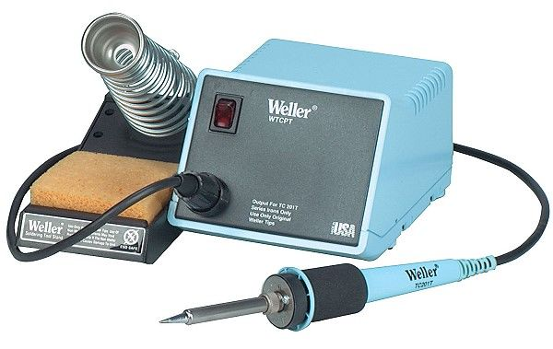
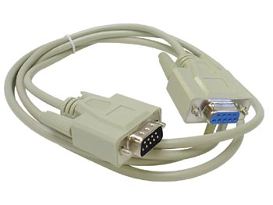
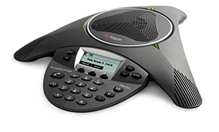
Available!
We have a soldering station in the Plugfest Room.
Wired and wireless internet provided
Power cords, mice, keyboards, monitors

Slide 6
No Photos
Please respect confidentiality of your colleagues.
All companies have agreed to UNH-IOL Usage Agreement
UNH-IOL may take some ‘generic’ photos.
If you would like a photo of your team, or your own equipment setup, please check with UNH-IOL staff first.

Slide 7
Travel
Visa Invitation Letter Contact:
Jkahn@iol.unh.edu
Shipping Address:
FCIA Plugfest ℅ James Kahn
21 Madbury Rd Suite 100
Durham, NH 03824
📞: 603-862-0090
Equipment must arrive by October 19th
Hotels, Travel, Parking Info:
https://www.iol.unh.edu/about/visit
Airports: ✈
MHT - Manchester Boston Regional Airport (🕐1 hr)
BOS - Boston Logan International Airport (🕒1hr 30mins)
Train: 🚄
Amtrak - Downeaster
Boston North Station > Durham-UNH
http://www.amtrakdowneaster.com/

Slide 8
Logistics
Plugfest runs Monday - Friday
Doors open at 8AM, testing until 5PM
Kickoff meeting Monday @ 11AM

Slide 9
Registration
Register here:
https://fibrechannel.org/plugfest-registration-payment/
Registration will close September 18th, 2023
NDA deadline is September 11th, 2023

Slide 10
Plugfest Planning Calls
ICC Calls
Two non-NDA calls (Today & Wednesday August 16th)
Followed by weekly NDA call from:
August 30th- October 18th

Slide 11
Email: jkahn@iol.unh.edu
Web: www.iol.unh.edu
Q&A

Slide 12
Q&A

